Slide 1
v
Black History Month
Exploring ‘Black Geographies’:
A topic within Human Geography

Slide 2
Learning Objectives
To learn what a geographical concept is and to appreciate how they can be used to explore topics within geography.
To gain an initial understanding of what the topic of ‘Black Geographies’ is.
To learn how geographers are exploring the topic of ‘Black Geographies’ and to examine how academics are using different geographic concepts as ‘lenses’ to research real-world issues.

Slide 3

Starter
In pairs, discuss how geographers use geographical concepts to help them in their work.
“Geographic concepts allow for the exploration of relationships and connections between people and both natural and cultural environments. They have a spatial component. They provide a framework that geographers use to interpret and represent information about the world.” (Ministry of Education, 2015: n.p)
Your second starter task: in pairs, discuss what geographical concepts you think you already know of.
Hint: you probably already use loads of geographical concepts in your work!
Space
Time
Place
Scale
Globalisation
Landscape
Systems
Flows
Development
Risk
Nature
Society
Urbanisation
And many more!

Slide 4

Geographical concepts are so important to geographers because they allow us to explore a single issue or place in different ways. Some academics describe this as looking at issues using different lenses as you can ‘see’ different things about a place when you look in a different way.

Slide 5
Example:
For example, we can look at your local High Street using different geographical concepts as different ‘lenses’ so that we can ‘see’ and explore different relationships.
We could look at your High Street in terms of ‘Globalisation’. We could think about all the different shops and what goods they are selling – where are the goods made, who made them, where the profit is going etc.
Or, we could look at your High Street in terms of ‘Risk’. Perhaps there’s a river nearby, which, if too much precipitation falls, will burst its banks. The High Street is at risk of being flooded.
You can see how we took the same place and looked at it through a different ‘lens’.
You will use geographic concepts in your work at whatever level of study (even if you don’t know it!).

Slide 6

Now we know what a geographical concept is….
The point of today’s lesson is to discuss how geographical concepts can be used to understand more about how different demographics of people use space.
Today, we will be looking at how the topic of ‘Black Geographies’ is offering us an insight into issues within the BAME community. Academics are using geographic concepts to explore it as a topic.

Slide 7
What is ‘Black Geographies’, and why is it an important topic to consider?
“Black geographies focus on the spatial knowledges and practices of black diasporic communities in the production of space and place” (Bledsoe, 2017; McKittrick, 2006, 2011; McKittrick and Woods, 2007, in Allen, Lawhon and Pierce, 2018)
  What this means is that the geographic topic of Black Geographies focuses in on creating understandings of how people from the BAME community interact with space and whether places are designed well to allow everyone to have fair an equal opportunities

Slide 8
What is ‘Black Geographies’, and why is it an important topic to consider?
McKittrick in Blackfeminisms.com (2017) argues that exploring Black Geographies allows geographers to expose issues connected to how Black people have historically experienced space differently to others.
  This sense of ‘otherness’ is a key topic within geography - are people excluded from certain places simply based on their skin colour?
Exploring the topics of ‘Black Geographies’ can allow geographers to ‘see’ a place or geographic issues from the perspective of another person.
For some, human geography is all about learning how other people use spaces and interact with society.
  By learning about others, we can reflect and understand how we can improve and make places accessible and welcoming for all.

Slide 9
What is ‘Black Geographies’, and why is it an important topic to consider?
One of the values a geographer should have is a desire to improve the world we live in.
  Black Geographies, as a topic, is so important to the evolution of geography, as an academic subject. By studying issues that surround the BAME community, society can progress in a way that includes all and attempts to correct historic injustices.
  Even in 2020, the BAME community are still being marginalised by aspects of society. That’s why us geographers need to take a lead and look at our history so that we can change our future.

Slide 10
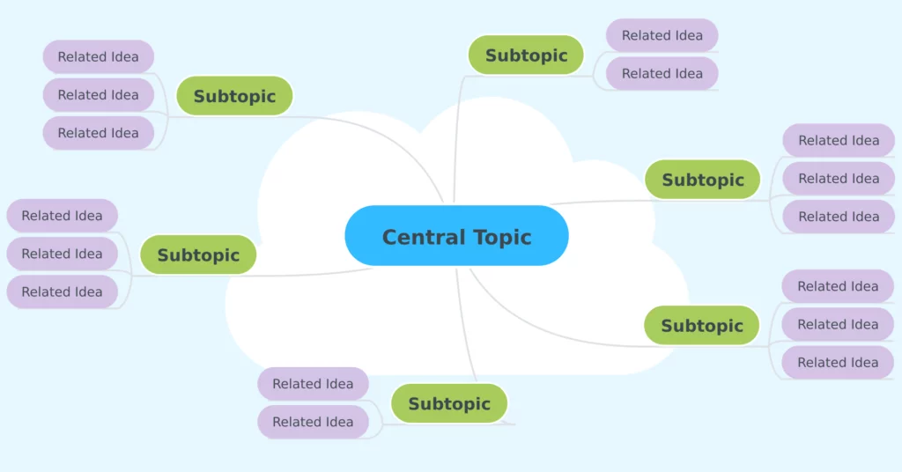
In groups…
Now you know a little bit about Black Geographies as a topic, can you make a Mind map of all the various ways that we could consider exploring it by using concepts?
You can put general themes on your Mind map to begin with and then narrow down your themes
  Extension: Can you think of any relevant examples?

Slide 11
My Mind map
This is an example Mind map – there may be some issues on this one that you didn’t think about and you might have produced more of your own!
Inclusion
How does this affect the community?
Black Geographies
Forced migration
Geographies of Opportunity
Places
Windrush scandal
Discrimination
Local services
Are places adapting to the needs of populations?
Does everyone have the same access to opportunities?
Health
Wellbeing
Education
The curriculum
Outcomes at A-level

Slide 12
What are academics currently researching?
Hirsch (2019) is researching how black geographies can be interpreted through the lens of health geographies, specifically in relation to the global response to the Ebola Outbreak. Their research project aims to expose whether past colonial impacts have had an affect on which countries received help during the Ebola Crisis, and to what extent racial issues are still affecting healthcare provisions around the world.
Esson (2018) is researching why the British geography curriculum is “so white”. Their research project aims to answer why geography is taught from a white perspective and what can be done to help shift geography to become a more inclusive subject. Esson argues that if black stories are taught within the geography syllabus, this would make British geographers to more effectively combat racism in society.

Slide 13
10-minute activity
Having just heard about two examples of what academics are currently studying Black Geographies through different lenses, your task is to design a research project with the topic of Black Geographies being at the center of your research. Your brief is:
You are a Professor of Human Geography and you want to deepen your understanding of issues that are affecting the BAME community within your local area. Choose one issue to focus on and explain to your classmates why it is an important topic to research.

Slide 14
Discussion
Share your research ideas with your classmates!

Slide 15
Plenary – what have we learnt today?
Share something you have learnt today with your partner.
Using the idea of exploring geographical ideas through ‘lenses’ can really help you in your work. Before you start an essay or exam question, perhaps you can think about what the question is actually asking you to answer. What is the ‘lens’ you need to ’look through’ when answering a specific question? If you take a few moments to think about what key concept you need to use to help you answer the question, you might address the question in greater depth!

Slide 16
Continue the conversation!
Head to the Royal Geographical Society to see their curated reading list for Black History Month (first published for Black History Month 2020) https://rgs-ibg.onlinelibrary.wiley.com/doi/toc/10.1111/(ISSN)1475-4959.black-geographies?
Visit https://www.blackgeographers.com to look at their campaign about the teaching of Geography in the UK by Black Geography Academics.

Slide 17
References
Allen, D., Lawhon, M., & Pierce, J. (2018). Placing race: On the resonance of place with black geographies. Progress In Human Geography, 43(6), 1001-1019. https://doi.org/10.1177/0309132518803775
Black Geographies: Mapping Black Spaces and Places. Blackfeminisms.com. (2017). Retrieved 8 October 2020, from https://www.blackfeminisms.com/black-geographies/.
Esson, J. (2018). “The why and the white”: Racism and curriculum reform in British geography. Area. https://doi.org/10.1111/area.12475
Hirsch, L. (2019). In the wake: Interpreting care and global health through Black geographies. Area, 52(2), 314-321. https://doi.org/10.1111/area.12573
Ministry of Education. (2015). Key concepts / Geography / Social sciences / Home - Senior Secondary. Seniorsecondary.tki.org.nz. Retrieved 8 October 2020, from https://seniorsecondary.tki.org.nz/Social-sciences/Geography/Key-concepts.

